Slide 1
JourneyBox – Smart Travel Companion App
CSE7302- University Project
Final Review
Batch Number: CSE_164
Under the Supervision of,
Ms.Delsy Jyothi
Assistant Professor
School of Computer Science and Engineering
Presidency University
Roll Number | Student Name
20221CSE0626 | THEJAS C
20221CSE0624 | T M TEJASHWINI
20221CSE0628 | VINAY K HIREMATH
Name of the Program: CSE7302-University Project
Name of the HoD: Dr. Blessed Prince
Name of the Program Project Coordinator: Mr.Muthuraju V
Name of the School Project Coordinators: Dr. Sampath A K

Slide 2
Content
Abstract
Objectives
Background
Existing Technologies
Proposed Approach
Architecture Diagram
Software Details
Timeline of the Project (Gantt Chart)
Project Output
GitHub Link
References

Slide 3
Abstract
Travel information today is scattered across emails, apps, and screenshots.
Leads to missed schedules, budget issues, and stress.
JourneyBox: a mobile app that centralizes trip planning, documents, expenses, and emergency support.
Features: offline access, map navigation, reminders, expense tracking.
Goal: convenience, safety, and organization in one platform.

Slide 4
Objectives
To develop a mobile application that can capture and store complete trip-related information (itinerary, bookings, documents, notes).
To provide organized trip management through a single dashboard for each journey.
To assist travelers with reminders and real-time trip support during travel.
To enable offline access to important trip details in low-network areas.
To help users track trip expenses and budgets for better financial planning.
To improve traveler safety by providing emergency contact and SOS support.

Slide 5
Background
Tourism sector growing rapidly worldwide.
Travel data: bookings, itineraries, payments, emergency contacts.
Issues: decentralized storage, poor offline access, safety risks.
India: urbanization + digital booking → high demand for integrated travel apps.

Slide 6
Existing Technologies
Govt tourism sites → static info only.
Booking/navigation apps → single functionality, no integration.
Research prototypes → limited usability, no offline/safety features.
Gap: need for an integrated, user‑centric travel management system.

Slide 7
Proposed Approach
Mobile app for trip planning, document storage, expense tracking.
Real‑time location services + contextual reminders.
Expense categorization and budget monitoring.
Universal use: leisure, education, work trips.
Limitations: internet dependency for real‑time services.

Slide 8
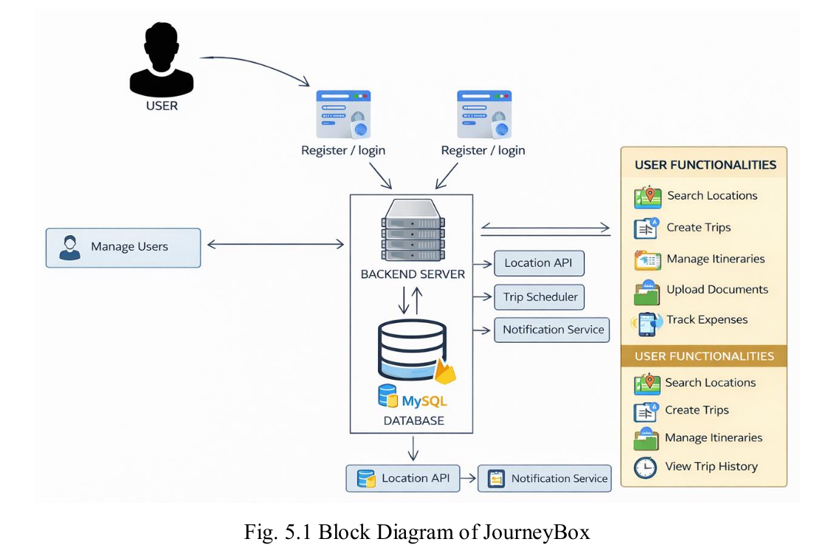
Architecture Diagram

Slide 9
Software Details
Android Studio
Java / Kotlin
Git & GitHub
Google Gemini API
FireBase FireStore

Slide 10
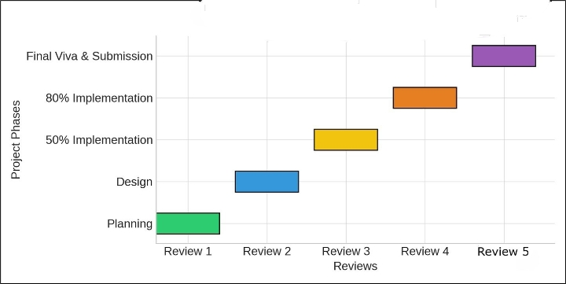
Timeline of the Project (Gantt Chart)

Slide 11
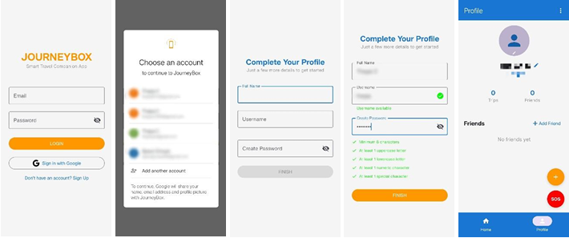
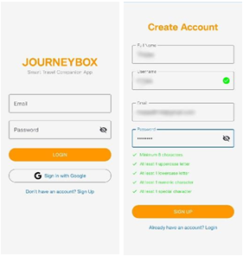
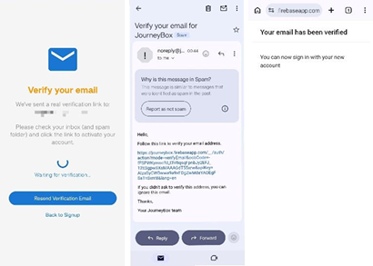
Project Output

Slide 12
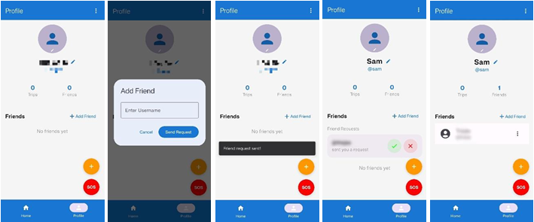
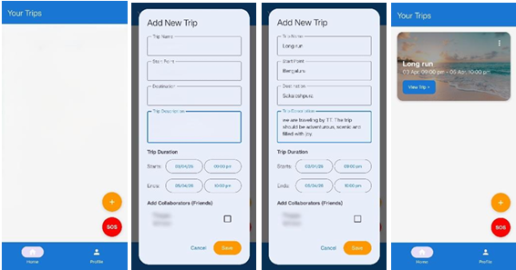
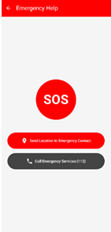
Project Output (Contd.)

Slide 13
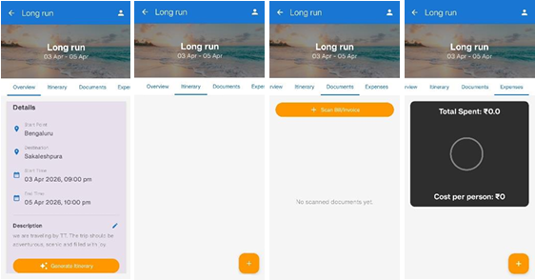
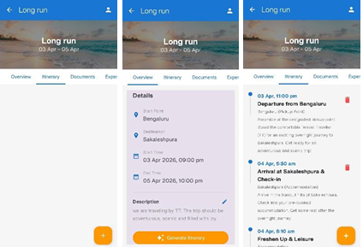
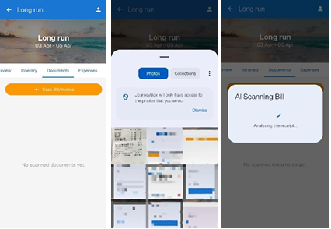
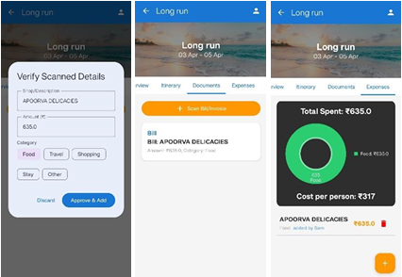
Project Output (Contd.)

Slide 14
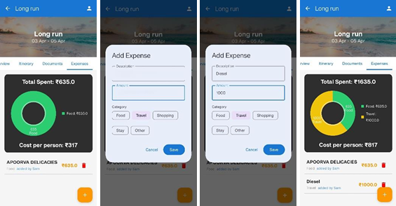
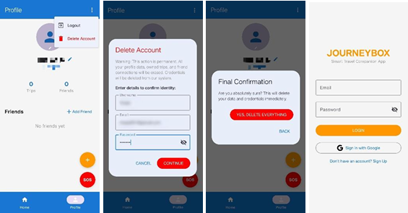
Project Output (Contd.)

Slide 15
Github Link
The Github link provided should have public access permission.
thejas-c/JourneyBox

Slide 16
References
[1] A. Dickinson, K. Ghali, M. Cherrett, J. Speed, N. Davies, and C. Norgate, “Tourism and the Smartphone App: Capabilities, Emerging Practice and Scope in the Travel Domain, Current Issues in Tourism, vol. 17, no. 1, pp. 84101, 2014.
[2] D. A. Amaranggana and Buhalis, Smart Tourism Destinations: Improving Tourism Experience using Personalisation of Services, in Proc. International Conference on Information and Communication Technologies in Tourism, 2015.
[3] M. Tussyadiah and D. Wang, Tourists Adoption of Mobile Application: Motivation, Satisfaction and Behavioural Intention, Journal of Travel Research, vol. 55, no. 8, 2016.
[4] P. Kaur and S. Sharma, A Smart Travel Planner Application with the Mobile Computing, in Proc. International Conference on Intelligent Communication and Computational Techniques (ICCT) 2018.
[5] X. Y. Zheng, K. H. Lim, and J. Yang, Mobile Travel Applications and their effects on tourist experience: A review, Tourism Management Perspectives, vol. 35, pp.100-110, 2020.

Slide 17
References
[6] Ahmed Alsharif et al., systematics review I: Smart Tourism, Hospitality, and Destination: A Systematic Review and Future Direction Systematic Review (Scopus SLR, accepted 2024) — 2013 to Nov 2023.
[7] Google Developers, “ML Kit Text Recognition v2," Google, 2024 — on-screen OCR that can be used in mobile apps (can be helpful in extracting tickets/receipts).
[8] Y. Y. Yap, “Smart Tourism, Technologies and Tourist Satisfaction,” Journal/ScienceDirect, 2025 — the literature on tourist satisfaction and smart tourism technologies.
[9] (Offline-first mobile architecture direction) “Local caching and sync patterns in Android Offline-First Architectures Implementation” / engineering papers and preprints (2024-25) - advice on the patterns of local caching and syncing of mobile applications.
[10] IJNRD / IJSRET / IJPREMS published studies (2024-2025) on expense-tracker mobile applications and implementations practical implementations and UX results on the expense tracking in mobile settings .

Slide 18


